Slide 1
Introduction to Physical Computing

Slide 2
What is physical computing?

Slide 3
What are smart devices?

Slide 4
Physical computing
"Physical Computing is an approach to learning how humans communicate through computers that starts by considering how humans express themselves physically" --Tom Igoe
Interacting with "smart" devices in the environment
Involves programming, electronics, 3d printing, wearables, networking, interaction design

Slide 5
Why learn this?
Jobs
2020: 26 billion Internet nodes (excl. phones, tablets, and computers)
30 fold increase from 2009
2020: 4.5 million Internet of Things (IoT) developers
57% annual growth rate
Cross-discipline
CS, EE, data analytics, product design, making entrepreneurship

Slide 6
Why learn this?
Hardware entrepreneurship
Cost of manufacturing is within reach of small amount of funding
Tools and open-source platforms mean you can build a prototype without an engineering degree
Empowering and fun
"We are on the verge of machines that can think, and we are carrying magic wands in our pocket but most people see them as read-only" -- Jeff Branson, educator and engineer

Slide 7
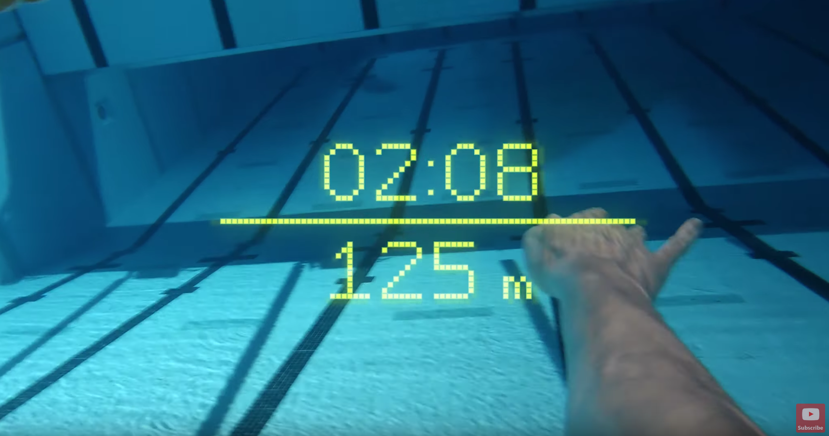
Examples: Gadgets
Mi.Mu / Imogen Heap
https://youtu.be/3QtklTXbKUQ?t=660
Form - AR swim googles

Slide 8
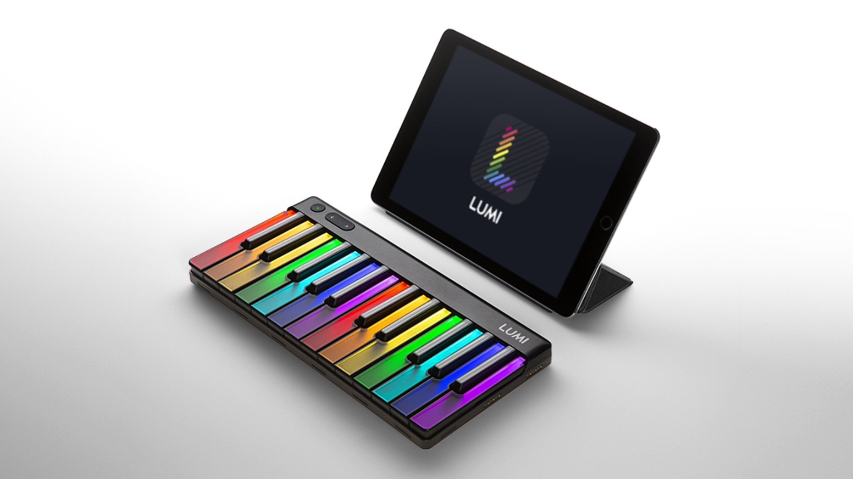
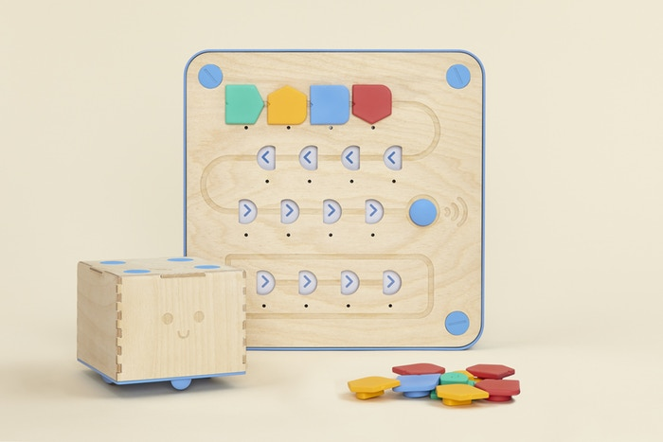
Examples: Education
Lumi – learn to play piano
Cubertto - learn programming without a screen

Slide 9

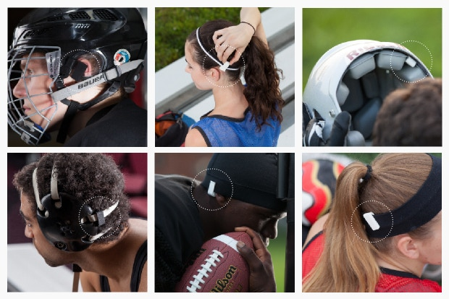
Examples: Health
UFO - beauty mask treatment
Jolt - concussion sensor for athletes

Slide 10
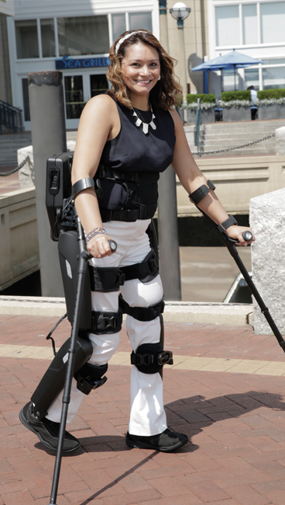
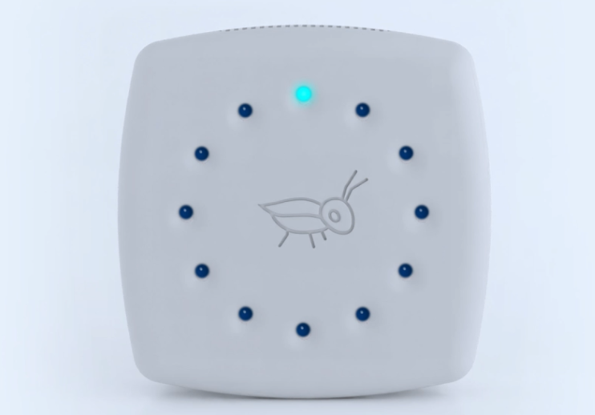
Examples: Social Good
Grillo - early earthquake warnings in rural Mexico and Chile
ReWalk - exoskeleton to help people with spinal cord injuries

Slide 11
What is IoT?

Slide 12
Internet of Things
Internet
connect to the internet to send and receive data
Things
"smart" devices that are programmed interact with environment

Slide 13
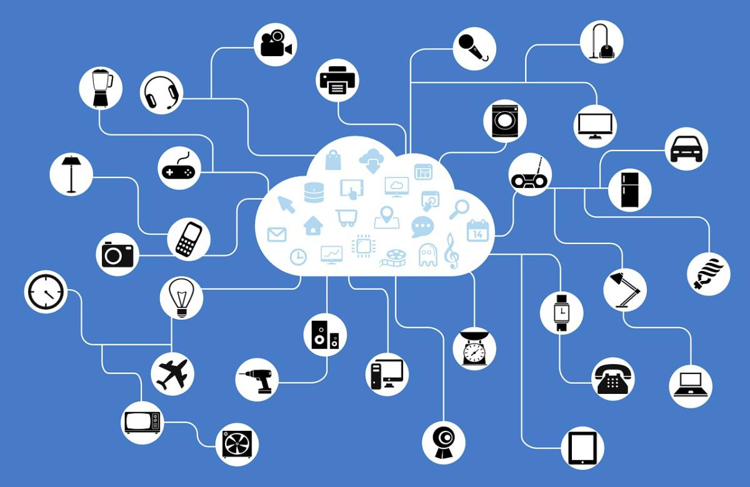
Internet of Things

Slide 14
Our focus in this class
building electronic prototype
creating the software code
communicating with / controlling device via internet

Slide 15
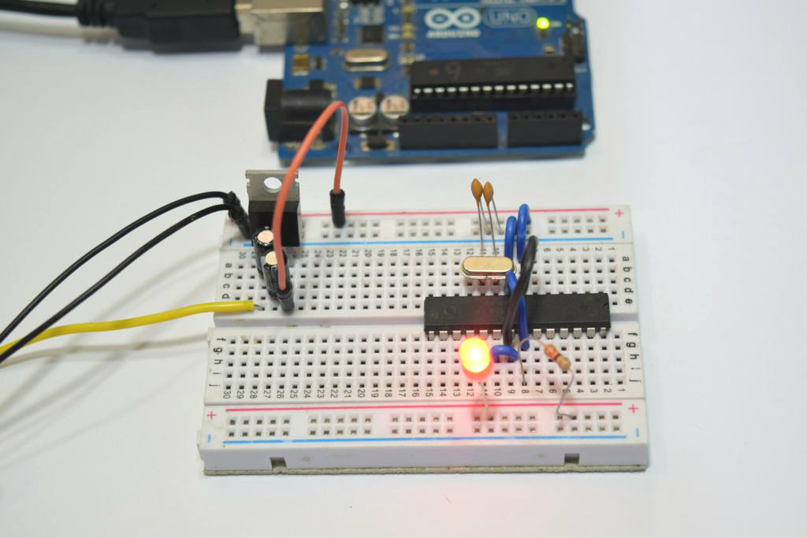
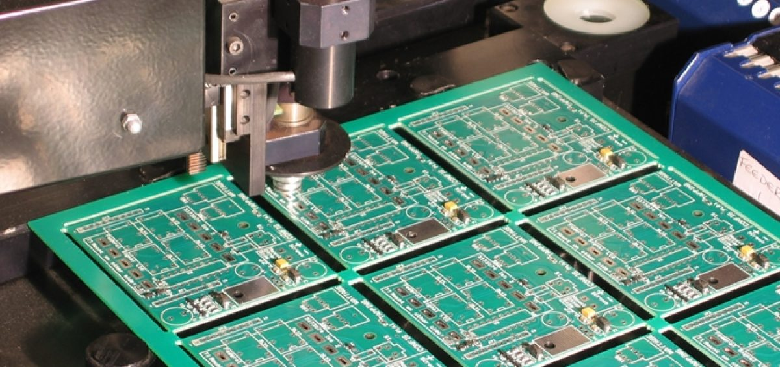
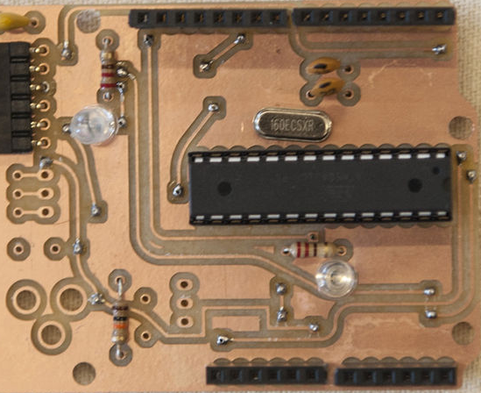
Hardware Stages
Basic prototype
PCB prototype
Fabrication

Slide 16
Communication
WiFi and Cellular
Bluetooth Low Energy (BLE)
Ex: Communication between smart watch and phone; wireless headphones
Range: ~1200+ ft
Near-Field Communication (NFC)
Ex: Contact-less payment like Apple Pay
Range: 4 inches

